Slide 1
Mouse thyroid tissue
Gene Expression analysis
Pink1 Knock-out

Slide 2

Tissue prep.
24-month B6 mouse thyroid tissue
- Pink1 K/O : 5ea
Sample ID: P2, P4, P6, P8, P9
- WT : 5ea
Sample ID: W5, W6, W7, W8, W9
RNA seq.
(illumina)

Slide 3
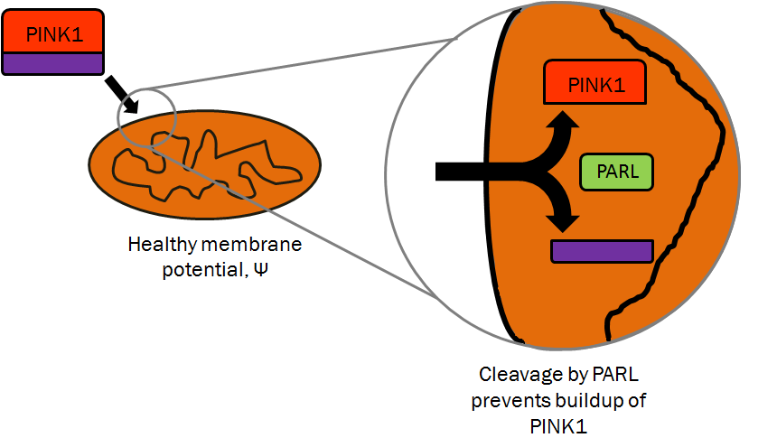
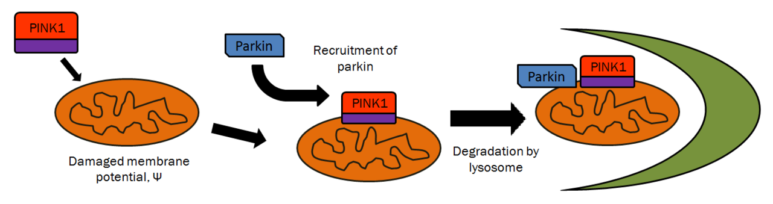
PINK1 – PTEN induced putative kinase 1
1. healthy
2. Damaged

Slide 4
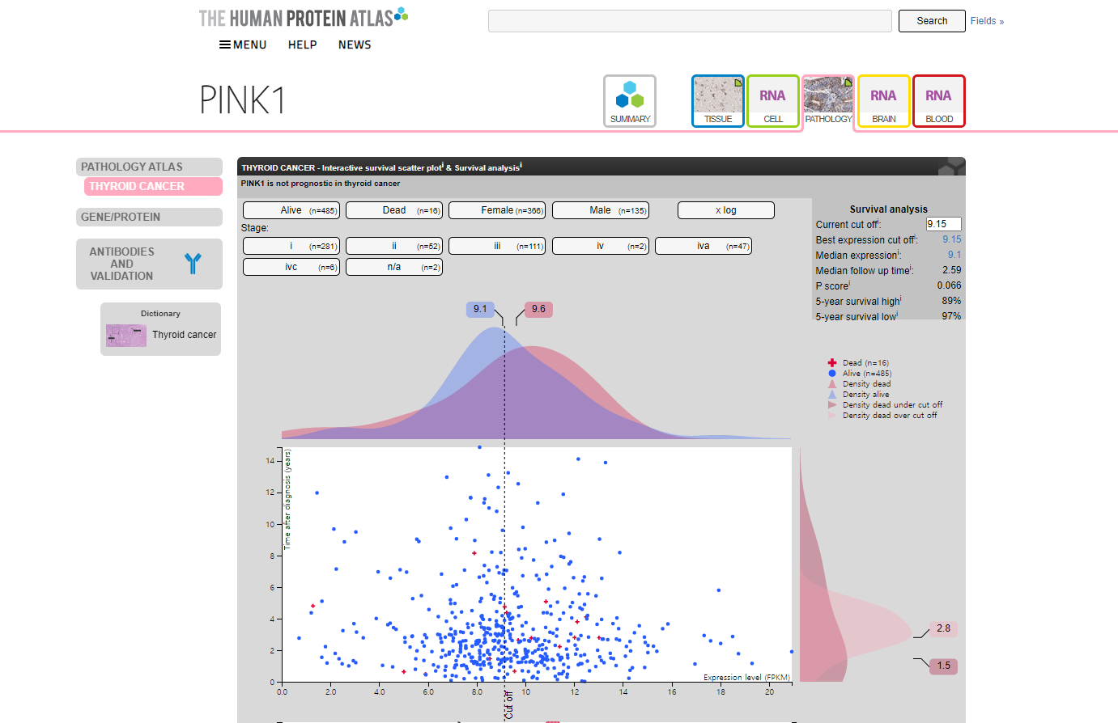
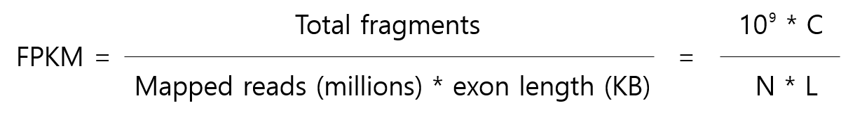
PINK1 – Expression in thyroid cancer

Slide 5
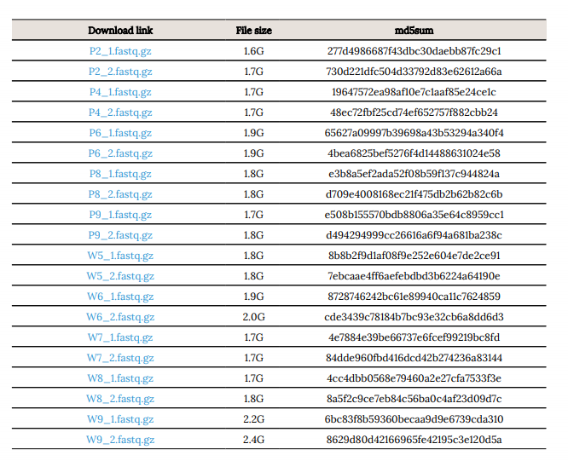
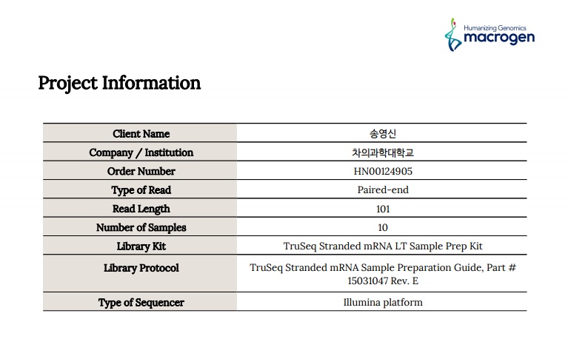
RNA sequencing - information

Slide 6
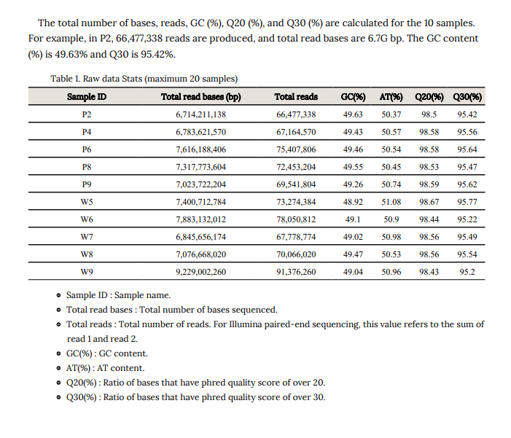
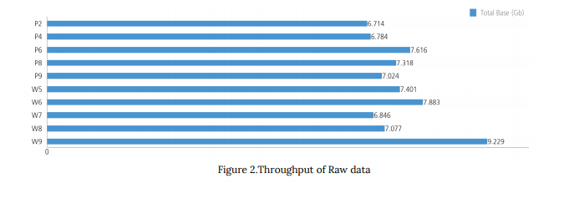
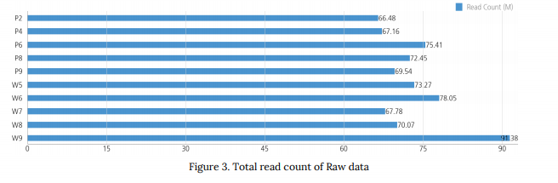
RNA sequencing – summary of data
Summary of data
Total read bases
Total reads

Slide 7
Analysis pipeline
QC
Alignment
Expression call
DEG
(Differentillay expressed gene)
Pathway
(Gene ontology)
FastQC
Trimmomatic
SortmeRNA
STAR
RseqC
HTseq
DEseq
Plotting - ggplot (Volcano, Heatmap…etc)

Slide 8
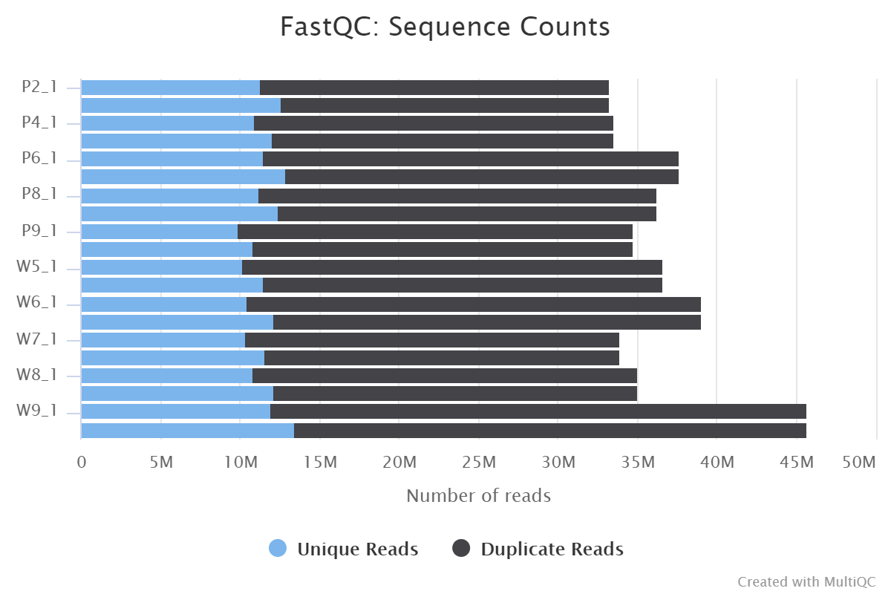
Quality control – MultiQC
General Statistics
Sample Name | % Dups | % GC | M Seqs
P2_1 | 66.0% | 49% | 33.2
P2_2 | 61.9% | 49% | 33.2
P4_1 | 67.4% | 49% | 33.6
P4_2 | 64.1% | 49% | 33.6
P6_1 | 69.6% | 49% | 37.7
P6_2 | 65.9% | 49% | 37.7
P8_1 | 69.0% | 49% | 36.2
P8_2 | 65.8% | 49% | 36.2
P9_1 | 71.5% | 49% | 34.8
P9_2 | 68.8% | 49% | 34.8
W5_1 | 72.1% | 48% | 36.6
W5_2 | 68.7% | 49% | 36.6
W6_1 | 73.1% | 48% | 39.0
W6_2 | 68.8% | 49% | 39.0
W7_1 | 69.5% | 48% | 33.9
W7_2 | 65.9% | 49% | 33.9
W8_1 | 69.0% | 49% | 35.0
W8_2 | 65.2% | 49% | 35.0
W9_1 | 73.8% | 48% | 45.7
W9_2 | 70.5% | 49% | 45.7

Slide 9
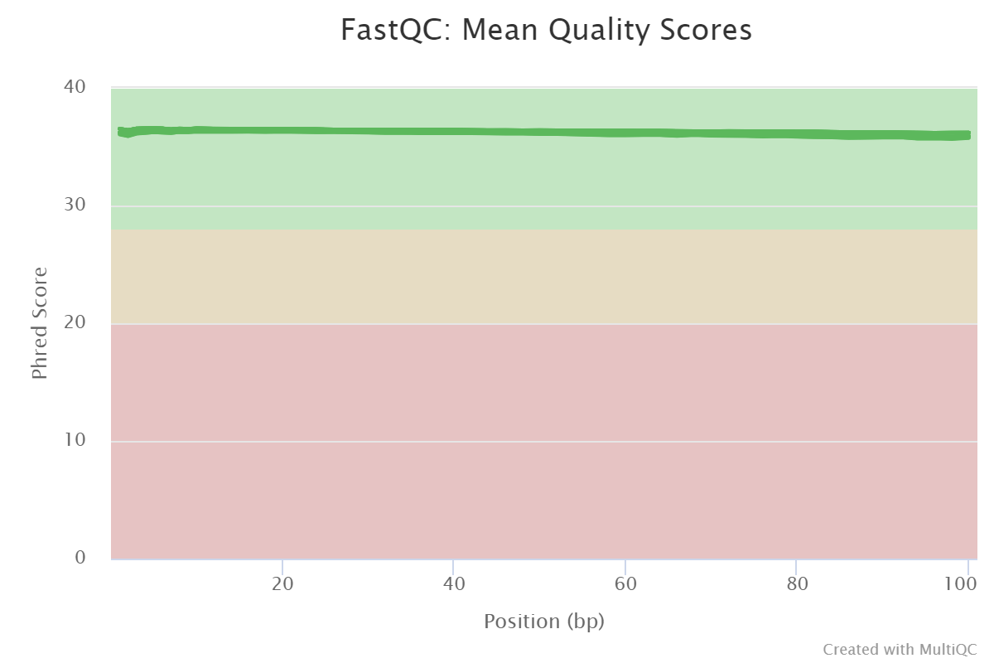
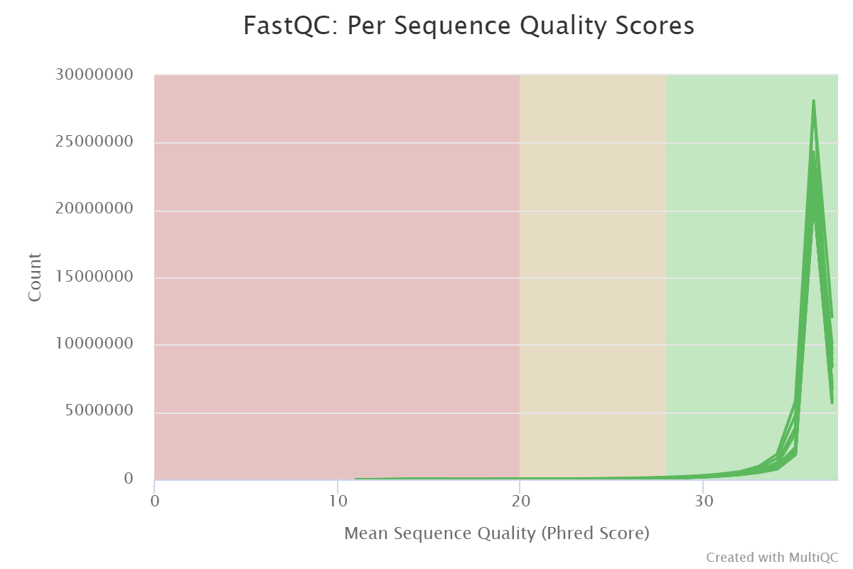
Quality control – MultiQC
Sequence Quality Histograms
Per Sequence Quality Scores
20 / 20 samples passed
20 / 20 samples passed

Slide 10

Quality control – MultiQC
Per Base Sequence Content ( Heatmap )
20 / 10 samples failed
20 / 10 samples with warning

Slide 11
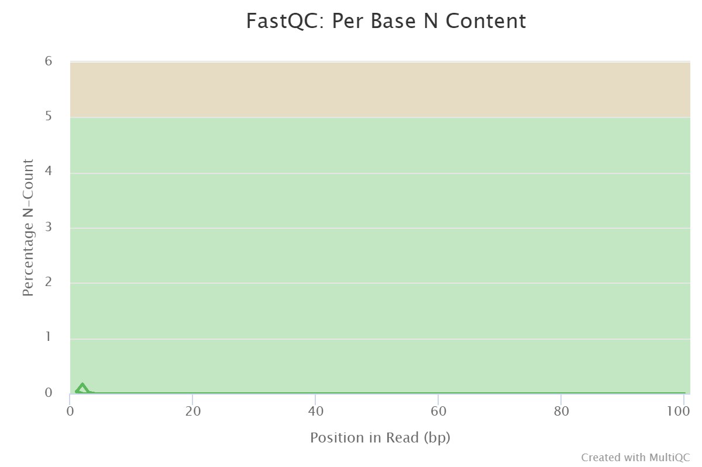
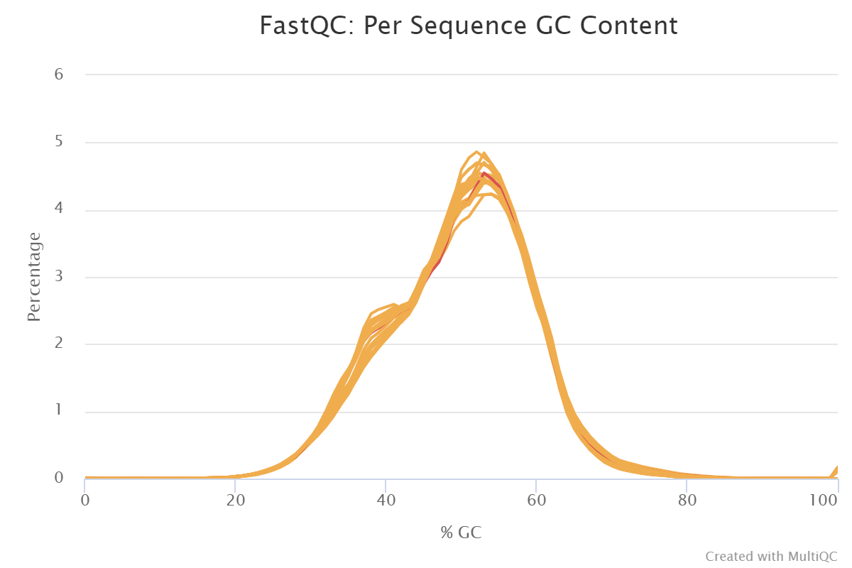
Quality control – MultiQC
20 / 1 samples failed : W6_2
20 / 20 samples passed
20 / 19 samples with warning

Slide 12
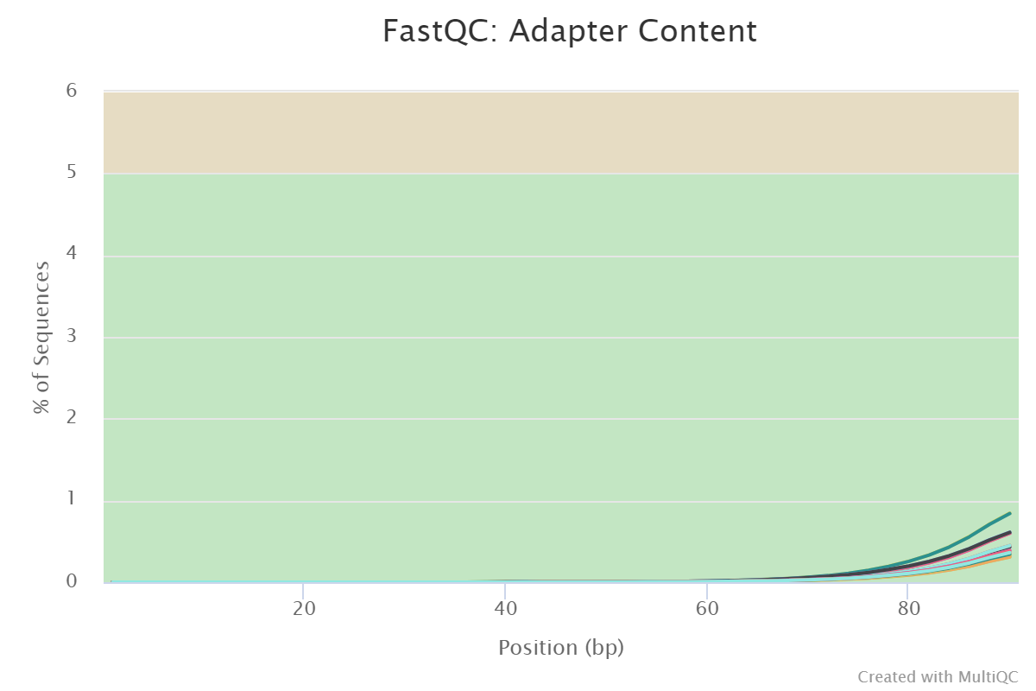
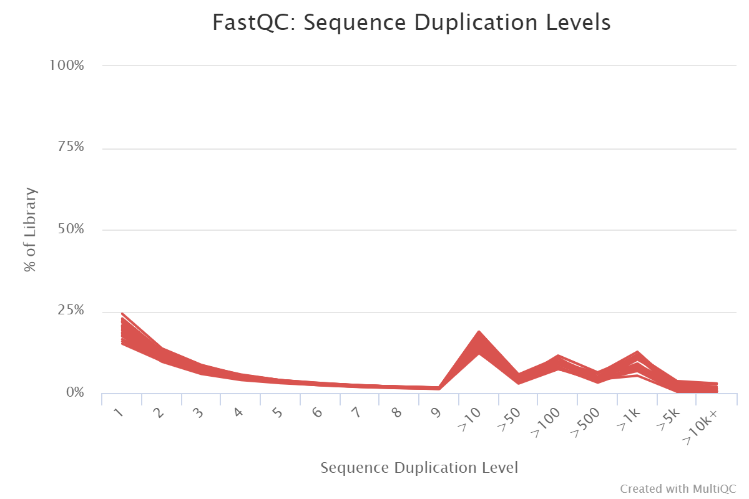
Quality control – MultiQC
20 / 20 samples failed
20 / 20 samples passed

Slide 13
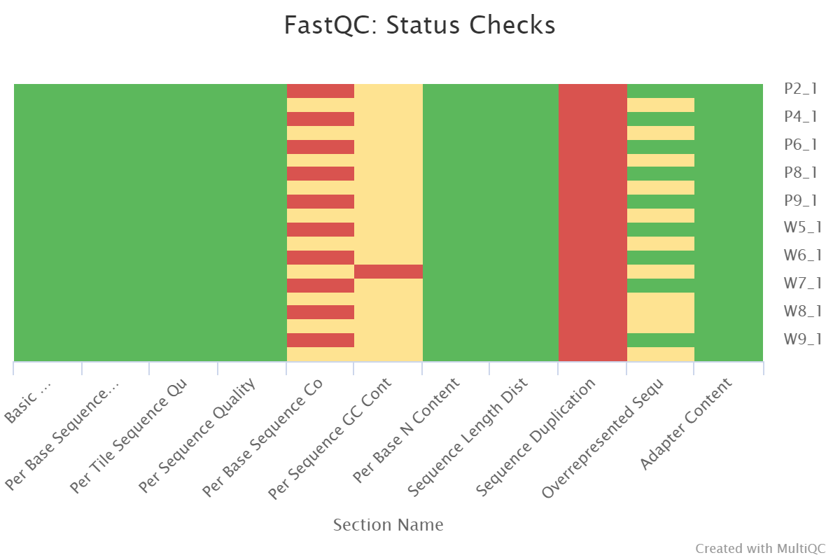
Quality control – MultiQC (Summary)

Slide 14
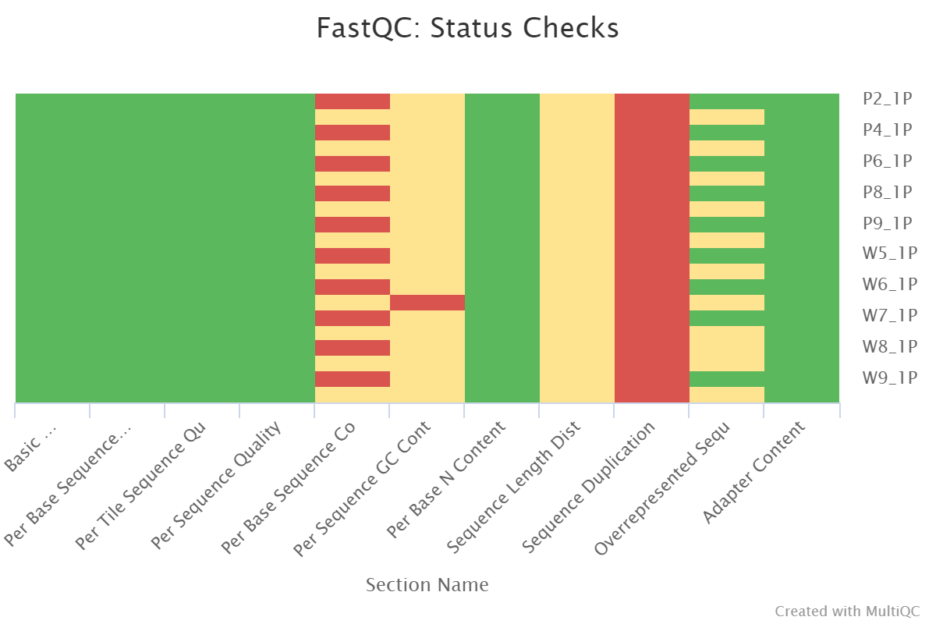
Quality control – after trimming
No samples found with any adapter contamination > 0.1%

Slide 15
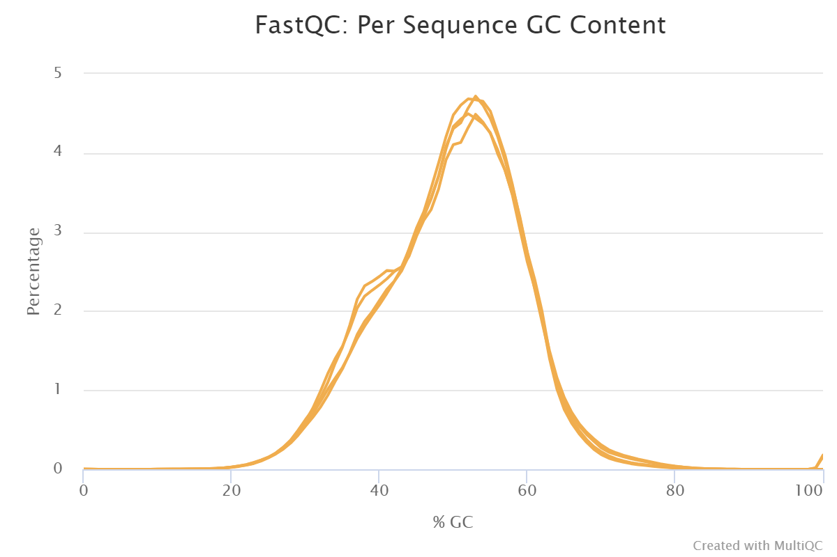
Quality control – SortmeRNA

Slide 16
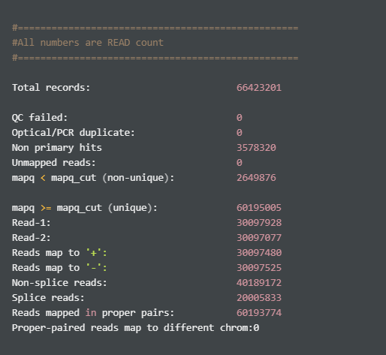
Alignment – STAR, RseqC
Total records: 전체 mapping 된 read 개수
QC failed: QC 에서 품질이 낮아 걸러진 read 개수
Non primary hits: best hit 이 아닌 다른 alignment 의 개수
Unmapped reads: mapping 이 되지 않은 read 개수
mapq < mapq_cut (non-unique): mapping quality 가 기준 미만으로, unique 하다고 볼 수 없는 read 개수
mapq >= mapq_cut (unique): mapping quality 가 기준 이상으로, unique 하다고 볼 수 있는 read 개수

Slide 17
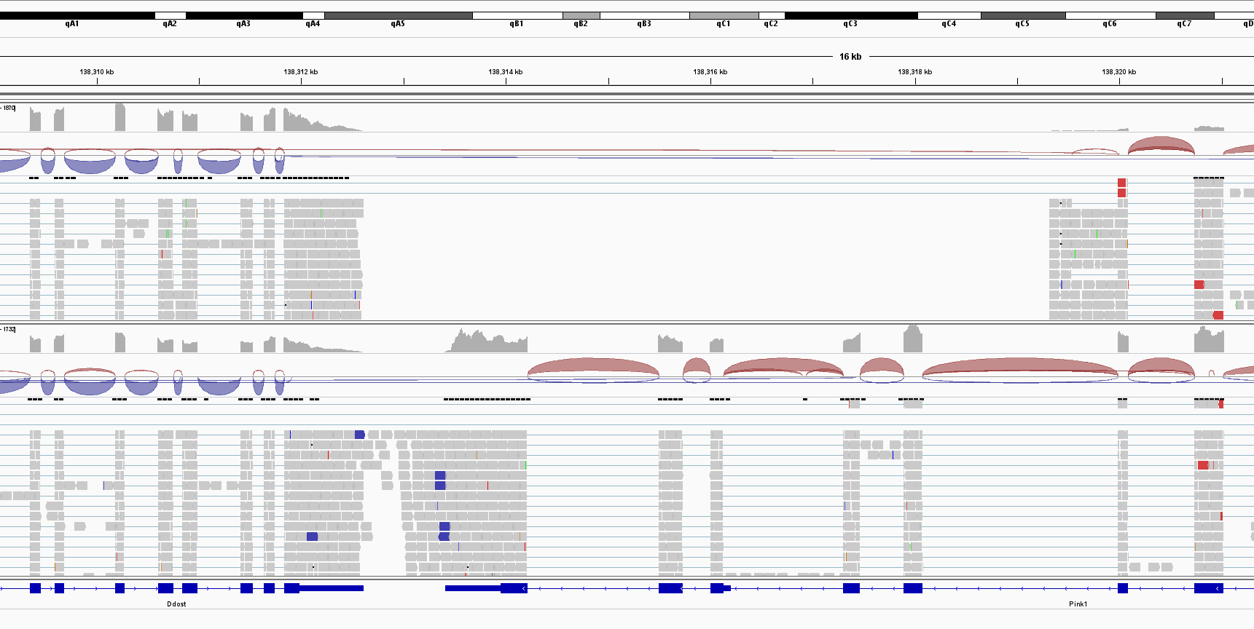
Alignment – IGV
deletion

Slide 18
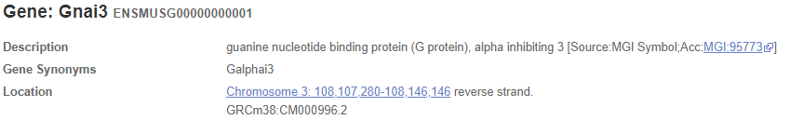
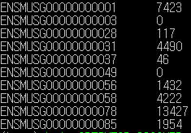
Expression call – HTseq
Read count -> TPM/FPKM

Slide 19
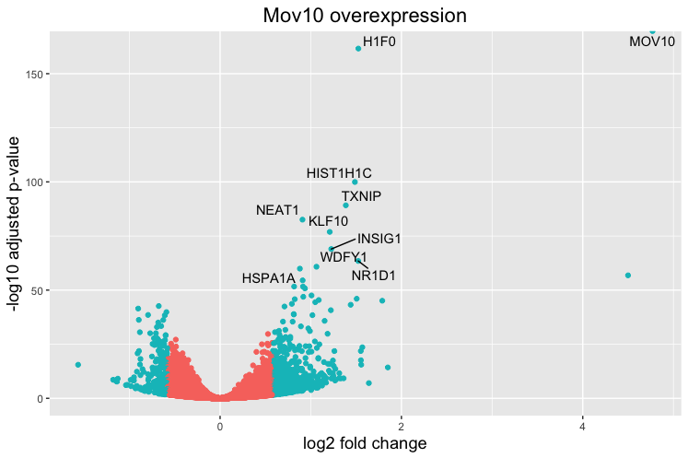
From now on…..
DEG plot example
DEG
(Differentillay expressed gene)
Pathway
(Gene ontology)
DEseq
Plotting - ggplot (Volcano, Heatmap…etc)

Slide 20
Mouse thyroid tissue
Gene Expression analysis
9/25 Fri.

Slide 21
Analysis pipeline
QC
Alignment
Expression call
DEG
(Differentillay expressed gene)
Pathway
(Gene ontology)
FastQC
Trimmomatic
SortmeRNA
STAR
RseqC
HTseq
DEseq2
DAVID, GSEA

Slide 22
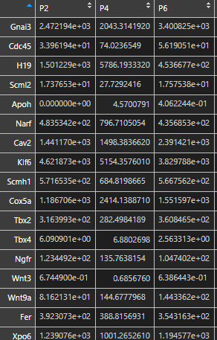
Differently expressed gene – DESeq2
1. Read counts normalization, gene name

Slide 23
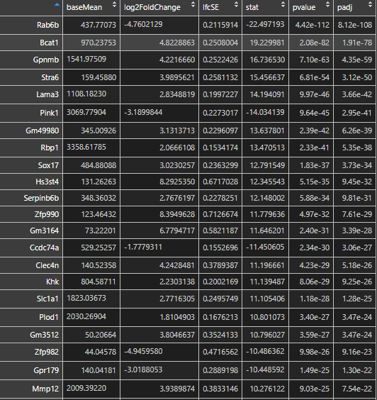
Differently expressed gene – DESeq2
2. DESeq2
Matrix plotting
PCA (Principal Component Analysis)
Sample to sample distance

Slide 24
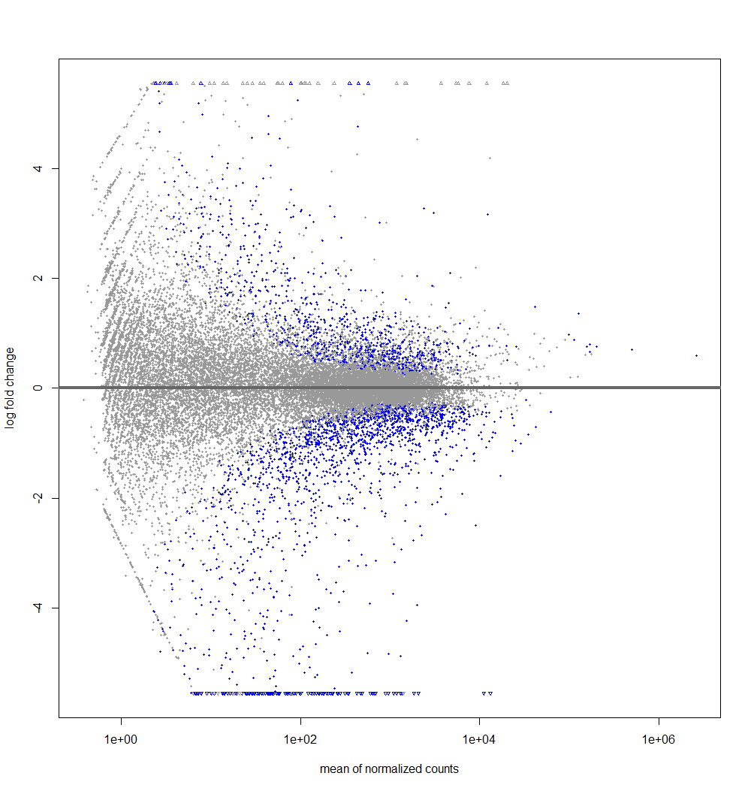
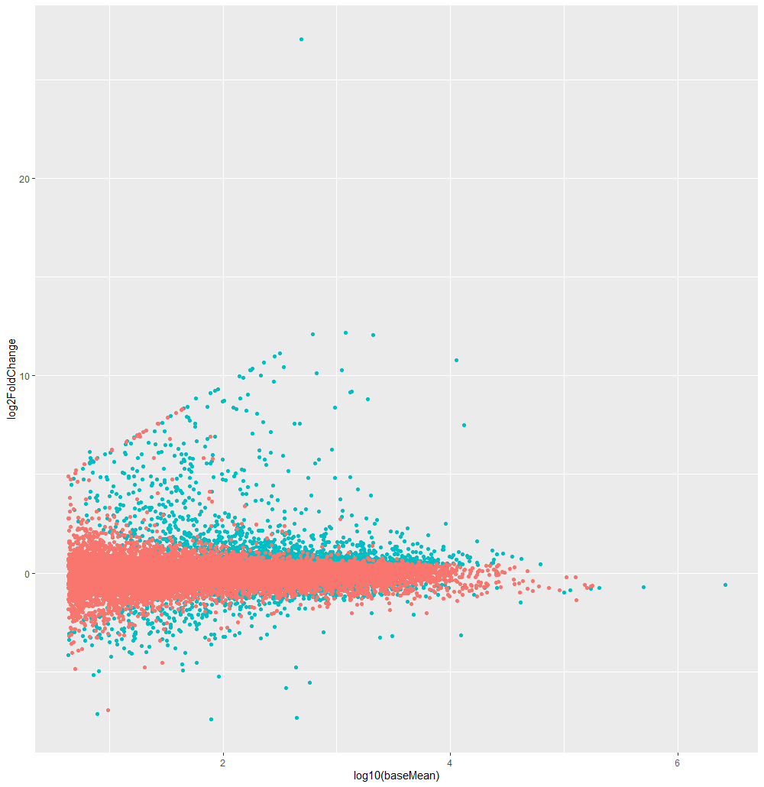
Differently expressed gene – DESeq2
PlotMA
PlotMA
(adjusted p-value < 0.05)

Slide 25
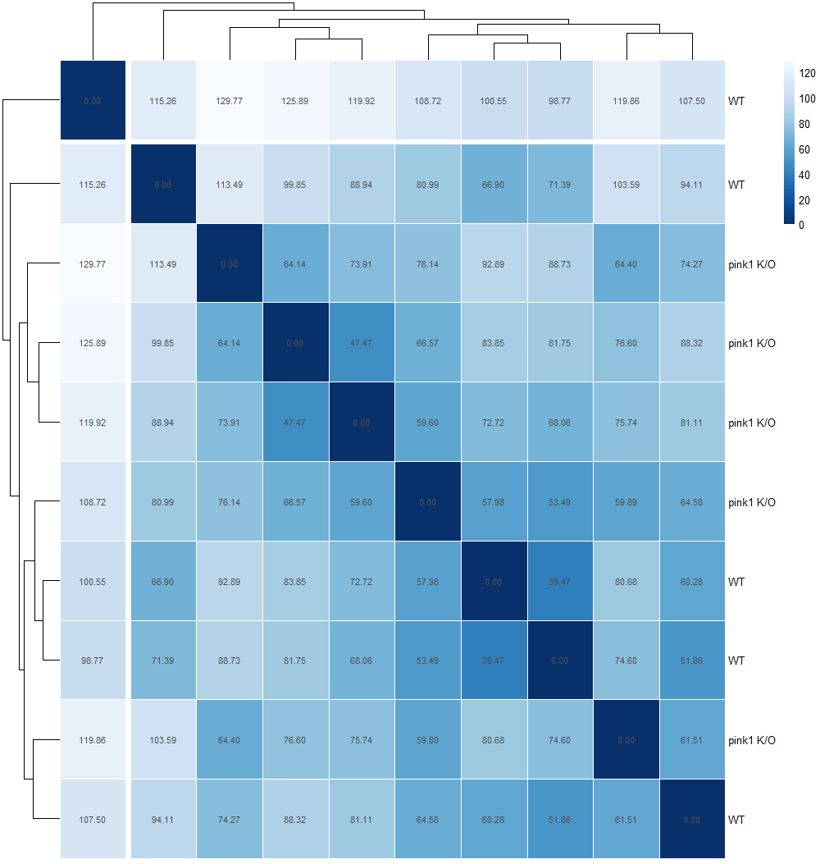
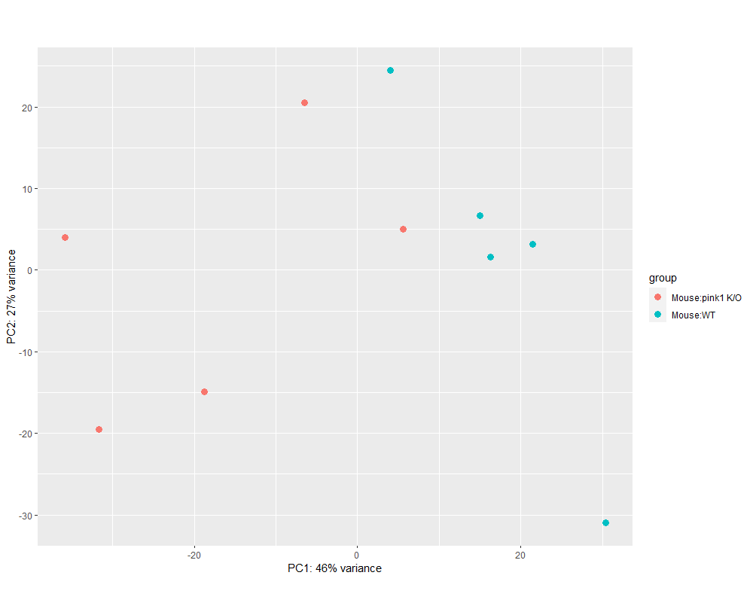
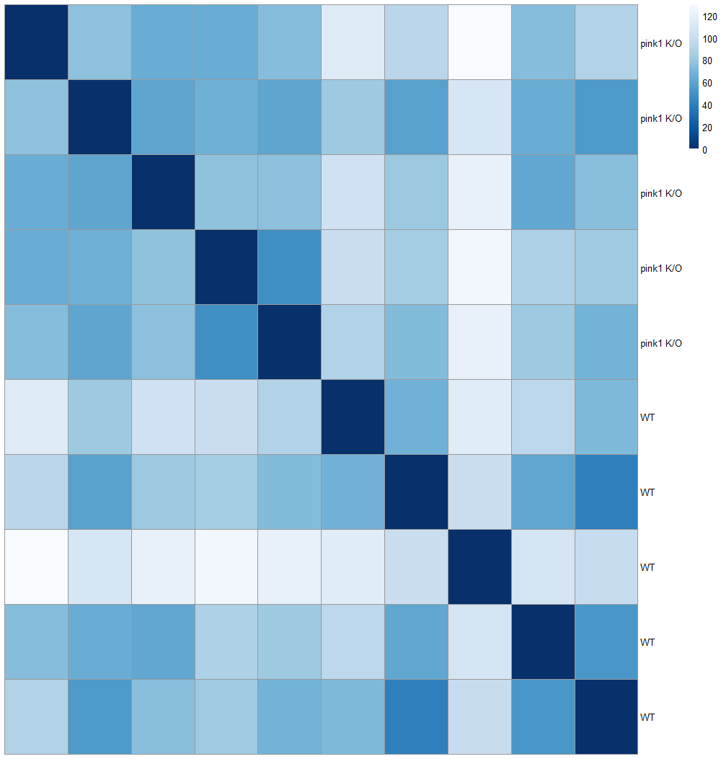
Differently expressed gene – DESeq2
Sample to sample distance
PCA

Slide 26
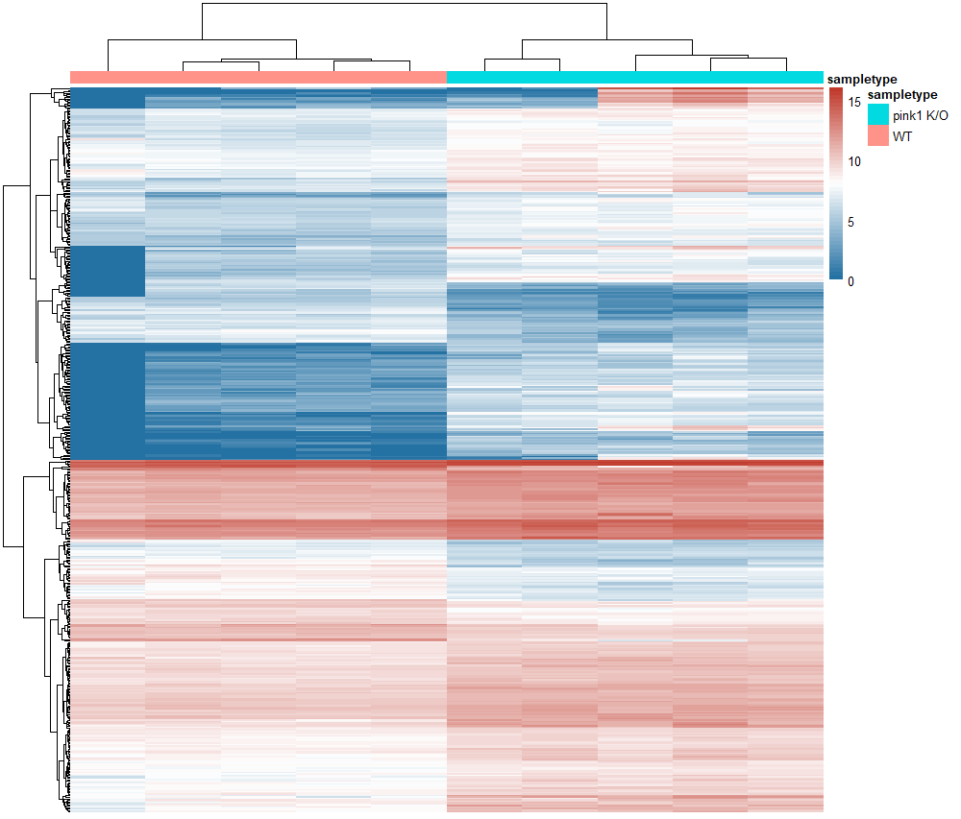
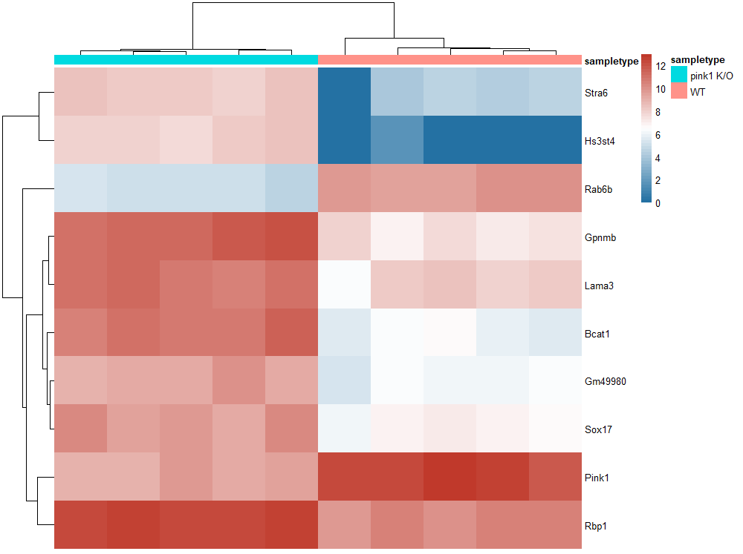
Differently expressed gene – DESeq2
Heatmap Top500 DE genes
Heatmap Top10 DE genes

Slide 27
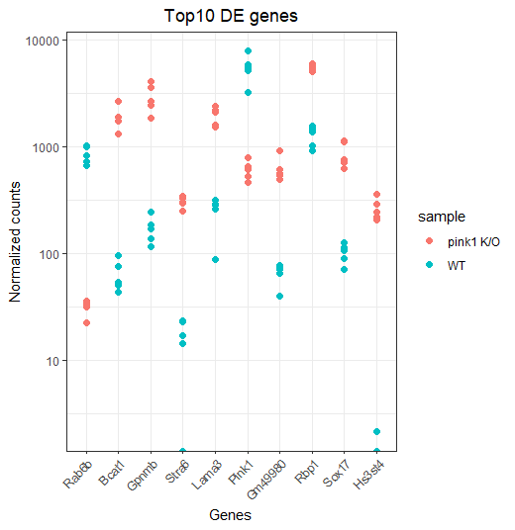
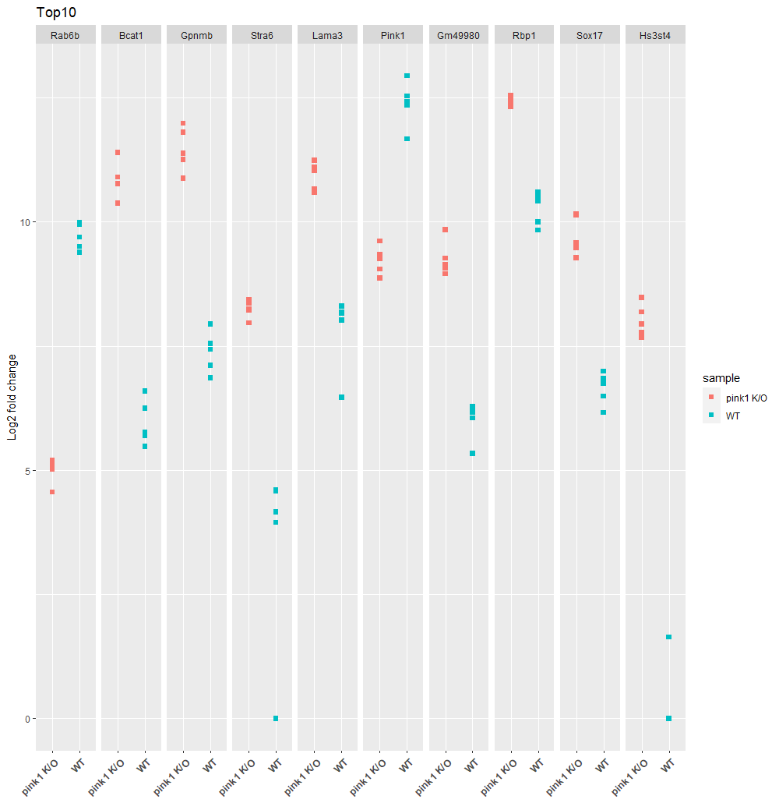
Differently expressed gene – DESeq2
Top10 DE genes (facet grid)

Slide 28
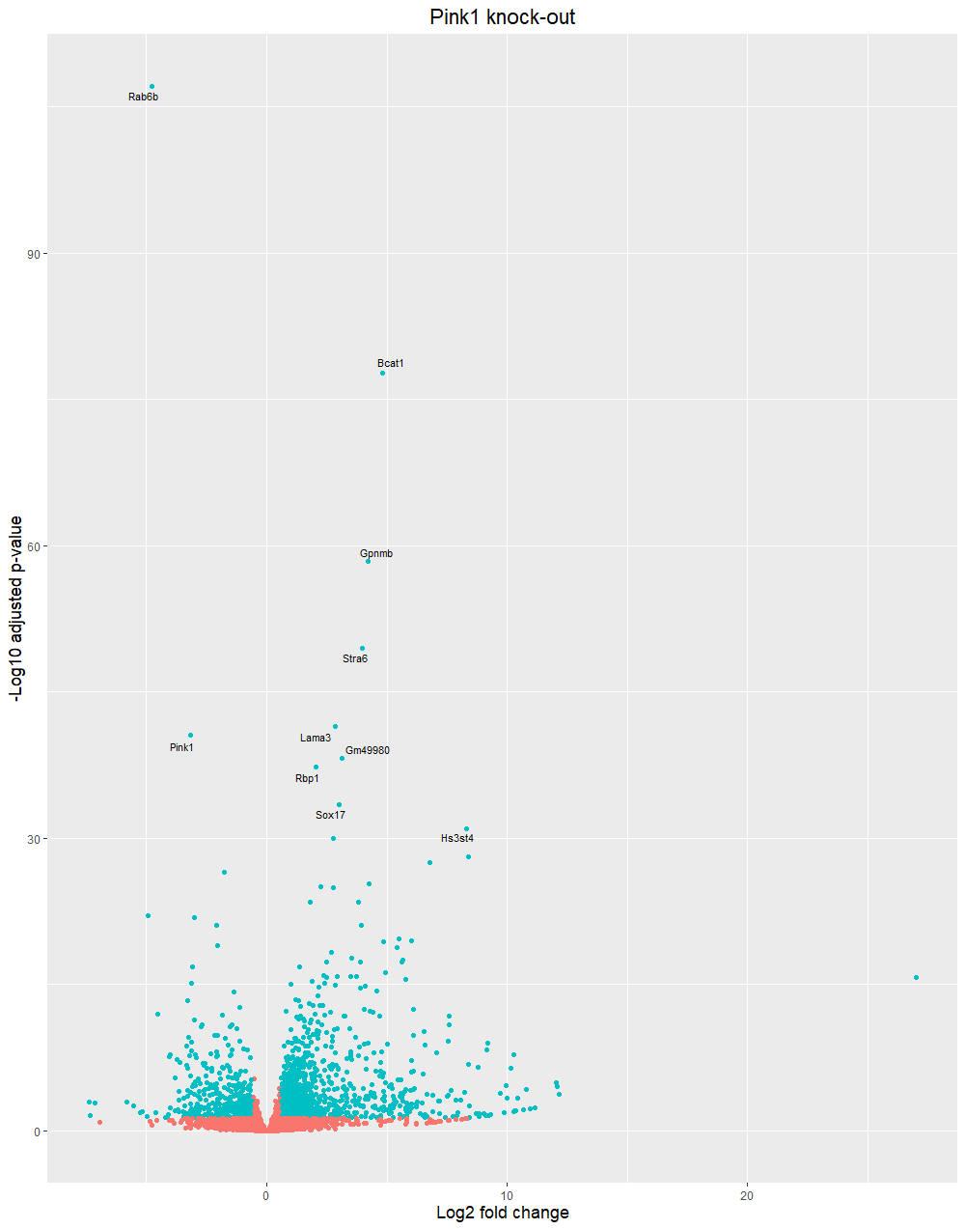
Differently expressed gene – DESeq2
Volcano
P-value | Mouse | Human
8.12E-108 | Rab6b | RAB6B
1.91E-78 | Bcat1 | BCAT1
4.35E-59 | Gpnmb | GPNMB
3.12E-50 | Stra6 | STRA6
3.66E-42 | Lama3 | LAMA3
2.95E-41 | Pink1 | PINK1
6.26E-39 | Gm49980 | ?
5.35E-38 | Rbp1 | RBP1
3.73E-34 | Sox17 | SOX17
9.45E-32 | Hs3st4 | HS3ST4
Linc RNA

Slide 29
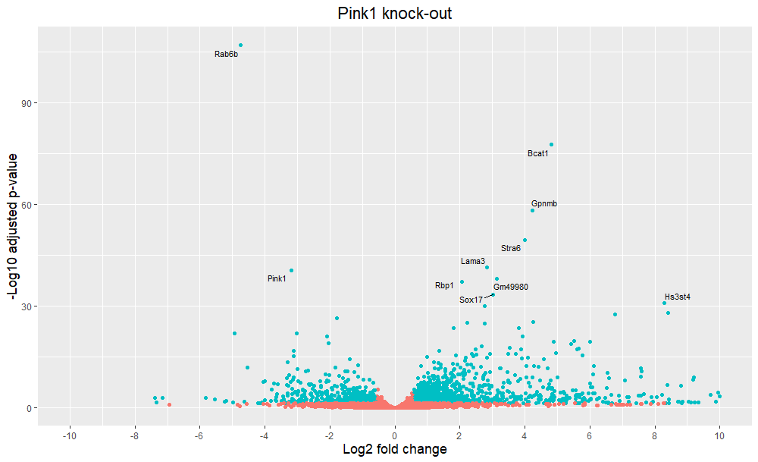

Slide 30
Differently expressed gene – DESeq2
P-value | Mouse | Human | Protein | Location
8.12E-108 | Rab6b | RAB6B | Ras-related protein Rab-6B (GTPase) | Golgi apparatus
1.91E-78 | Bcat1 | BCAT1 | Branched Chain Amino Acid Transaminase 1 | Cytoplasm
4.35E-59 | Gpnmb | GPNMB | Glycoprotein Nonmetastatic Melanoma Protein B | Plasma membrane (cell mem, endosome)
3.12E-50 | Stra6 | STRA6 | Receptor for retinol uptake STRA6 | Plasma membrane
3.66E-42 | Lama3 | LAMA3 | laminin subunit alpha 3 | Extracellular region or secreted
2.95E-41 | Pink1 | PINK1 | PTEN-induced kinase 1 | Cytosol, mitochondrion
6.26E-39 | Gm49980 | ? | (predicted gene) ? | ?
5.35E-38 | Rbp1 | RBP1 | Retinol-binding protein 1 | Cytoplasm (?)
3.73E-34 | Sox17 | SOX17 | Transcription factor SOX-17 | Nucleus
9.45E-32 | Hs3st4 | HS3ST4 | Heparan sulfate glucosamine 3-O-sulfotransferase 4 | Golgi apparatus

Slide 31
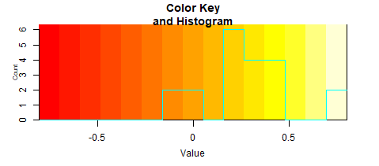
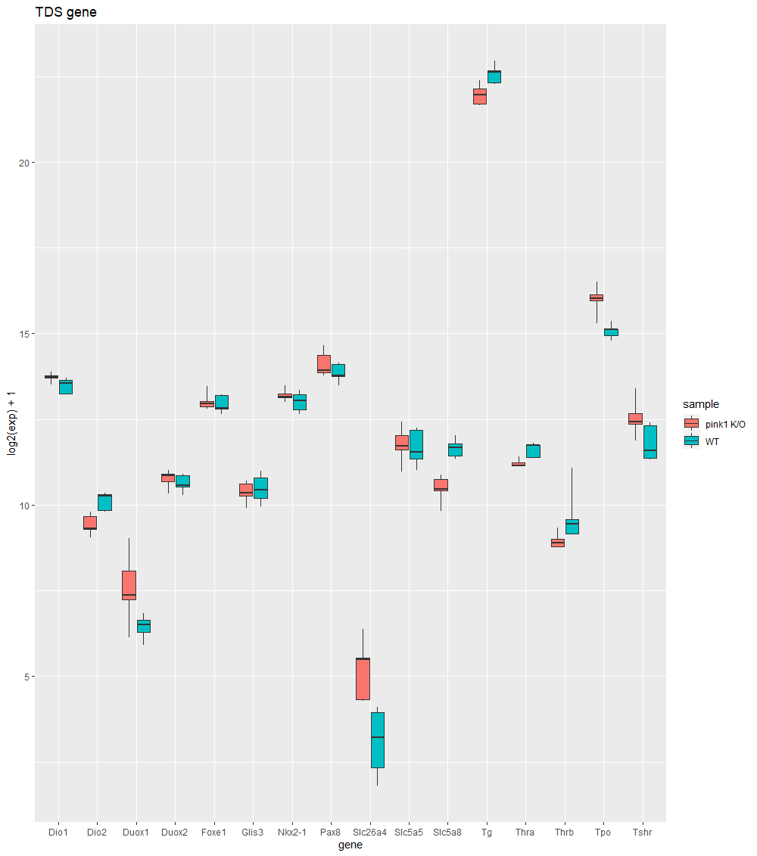
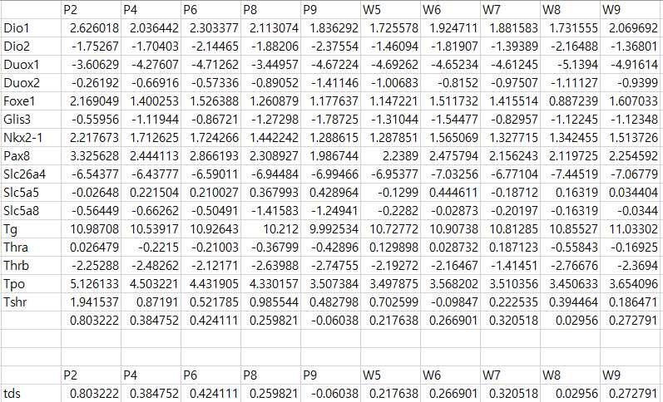
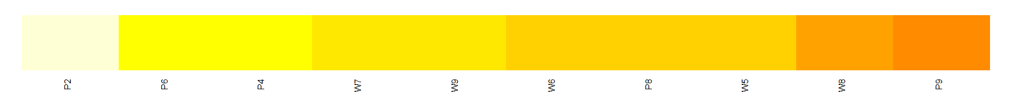
TDS analysis
 | TDS(mean)
Pink1 K/O | 0.362305
WT | 0.221482
 | P2 | P4 | P6 | P8 | P9 | W5 | W6 | W7 | W8 | W9
TDS | 0.803222 | 0.384752 | 0.424111 | 0.259821 | -0.06038 | 0.217638 | 0.266901 | 0.320518 | 0.02956 | 0.272791

Slide 32
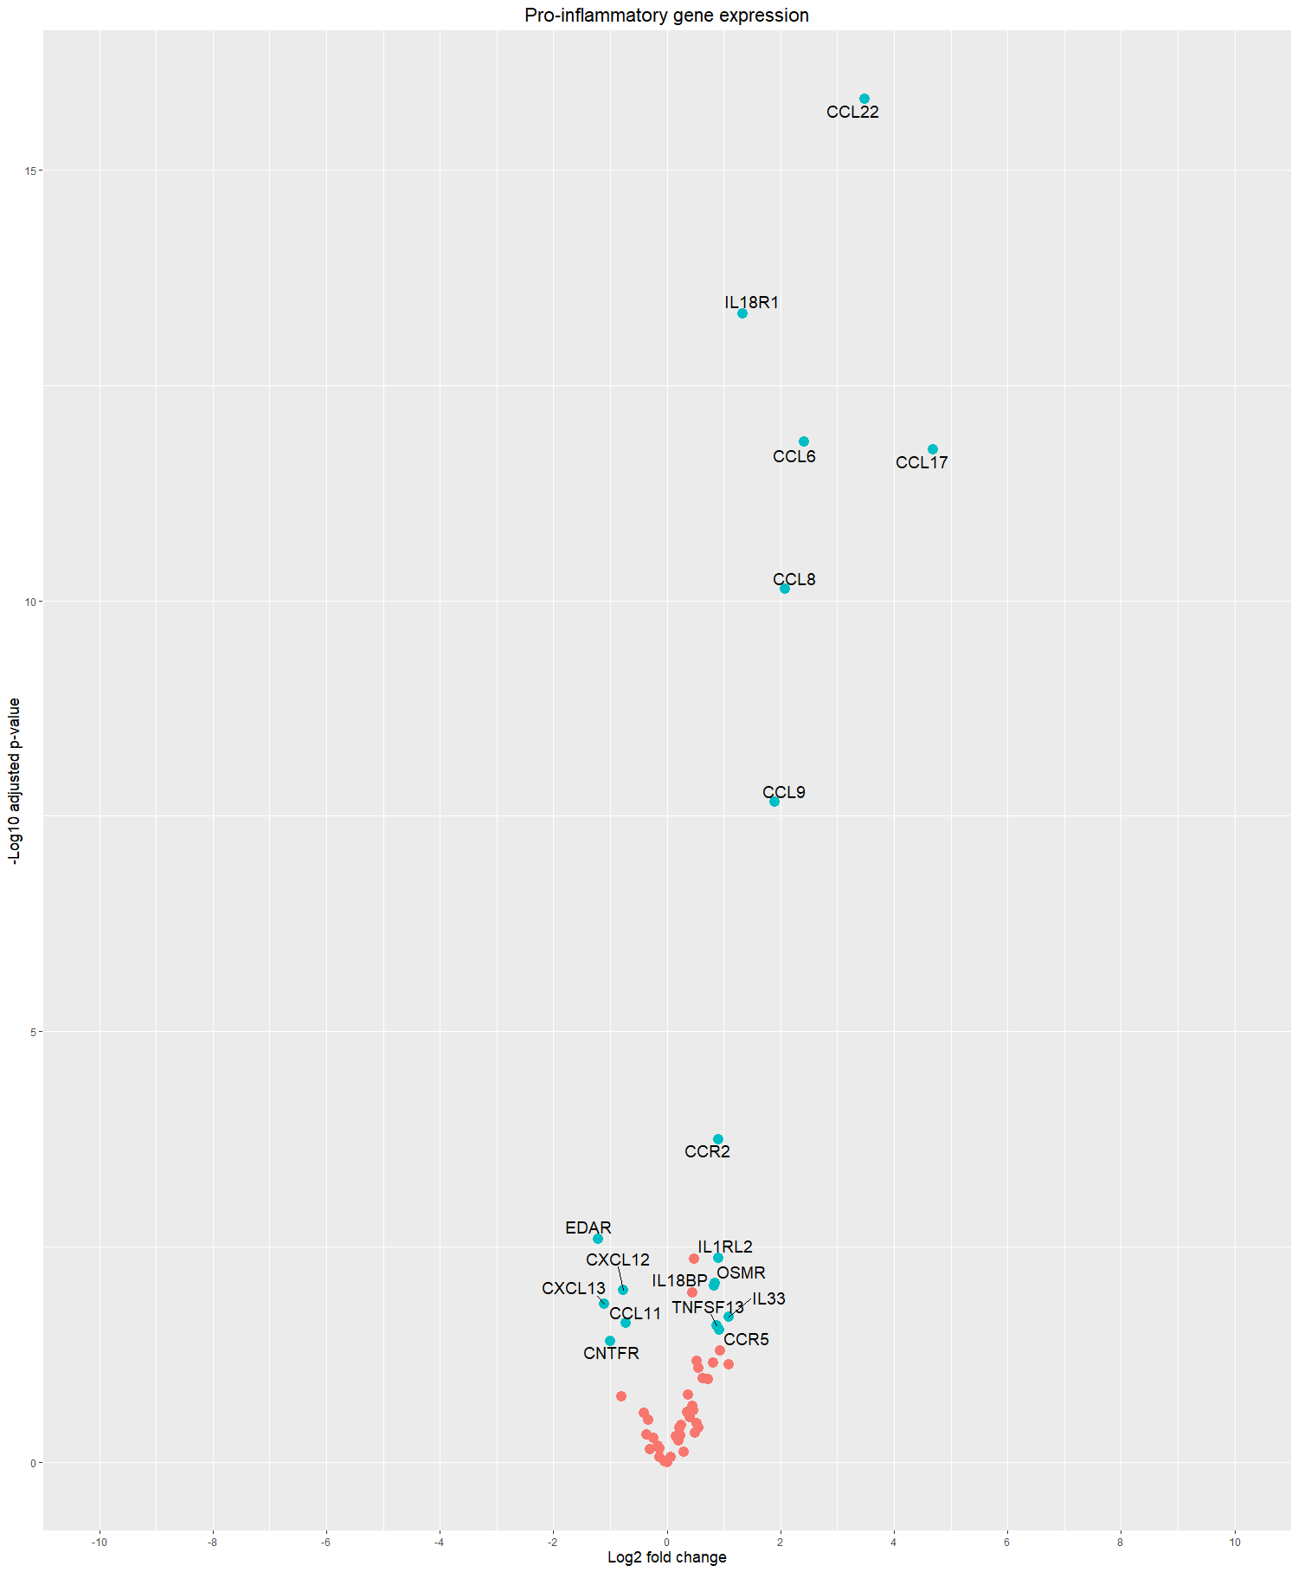
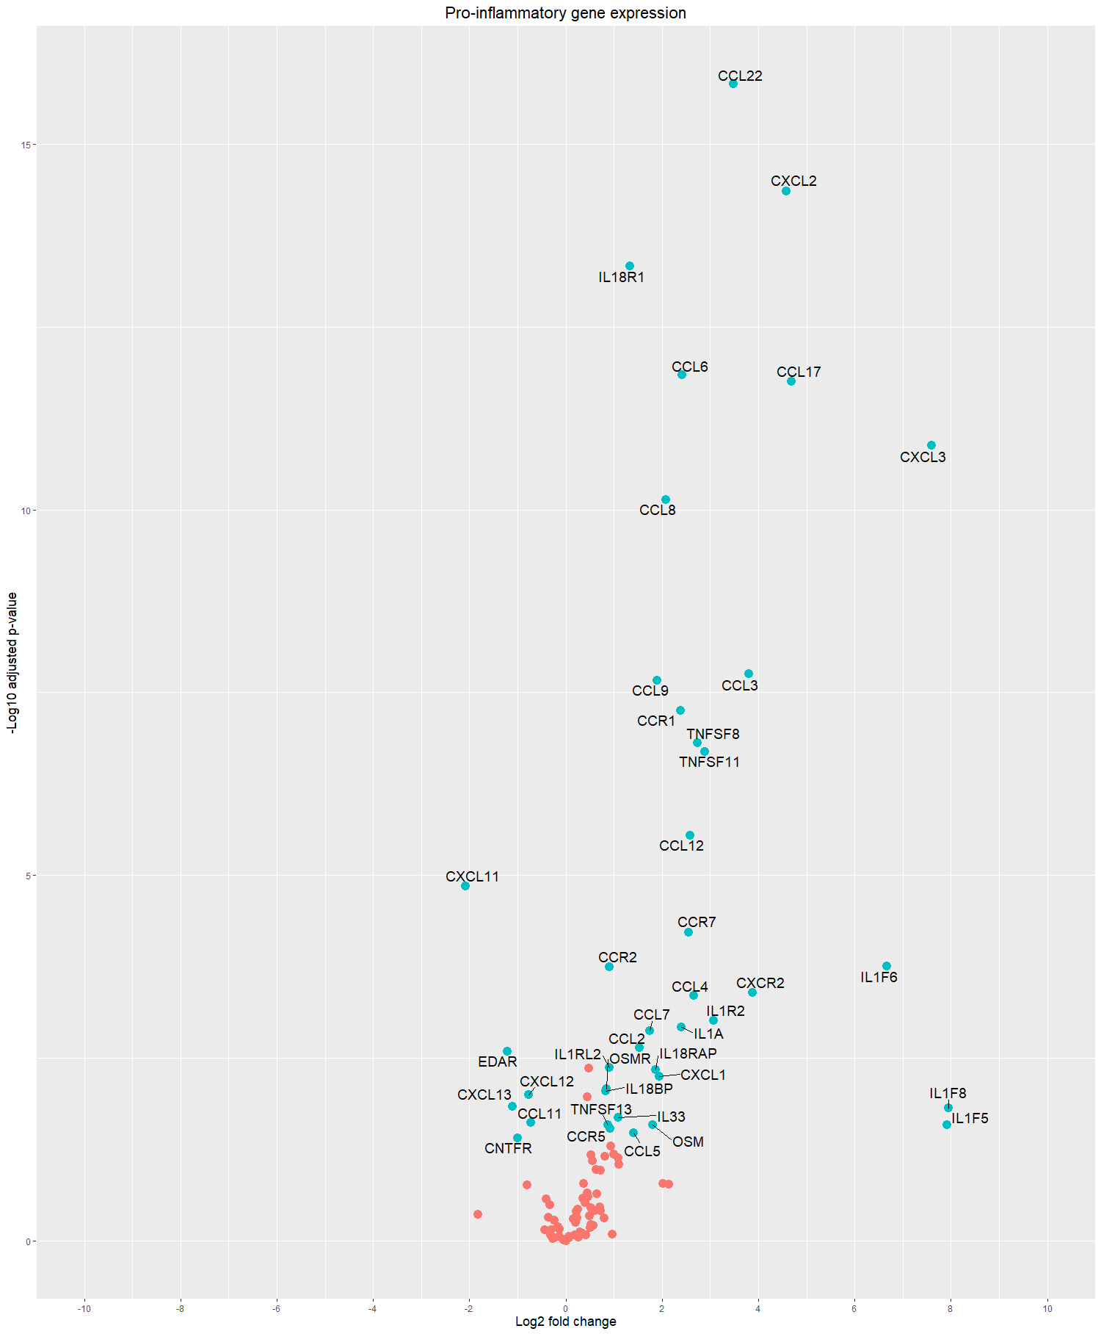
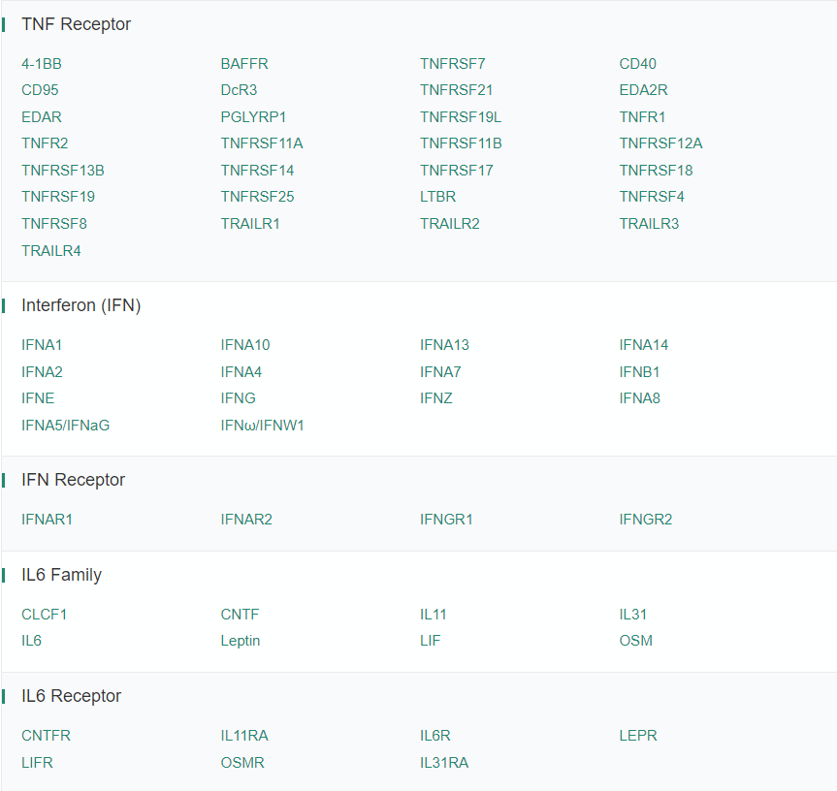
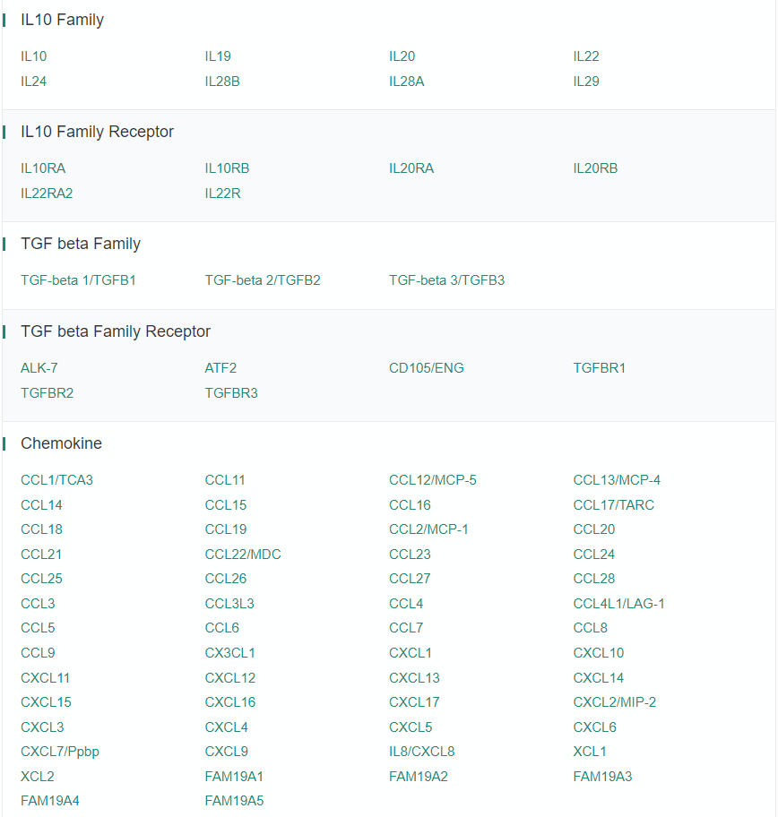
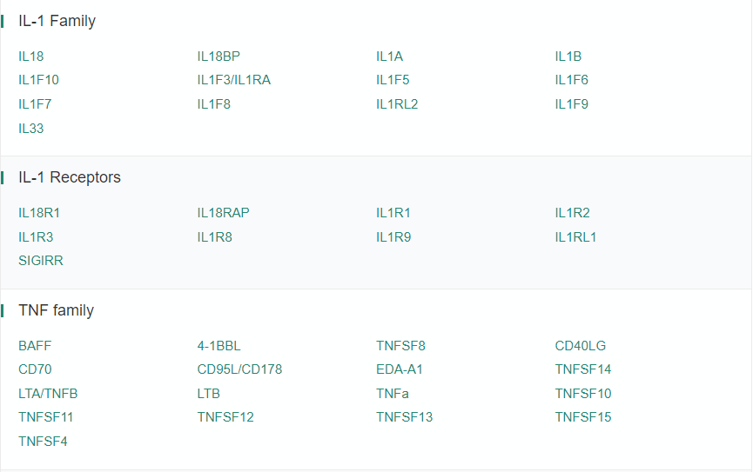
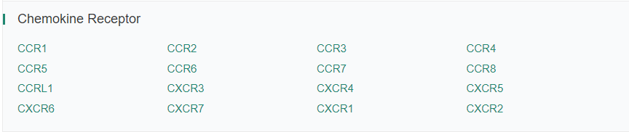
Pro-inflammatory gene
Adj p-value < 0.05
Log fold change > 0.58
baseMean >= 100

Slide 33
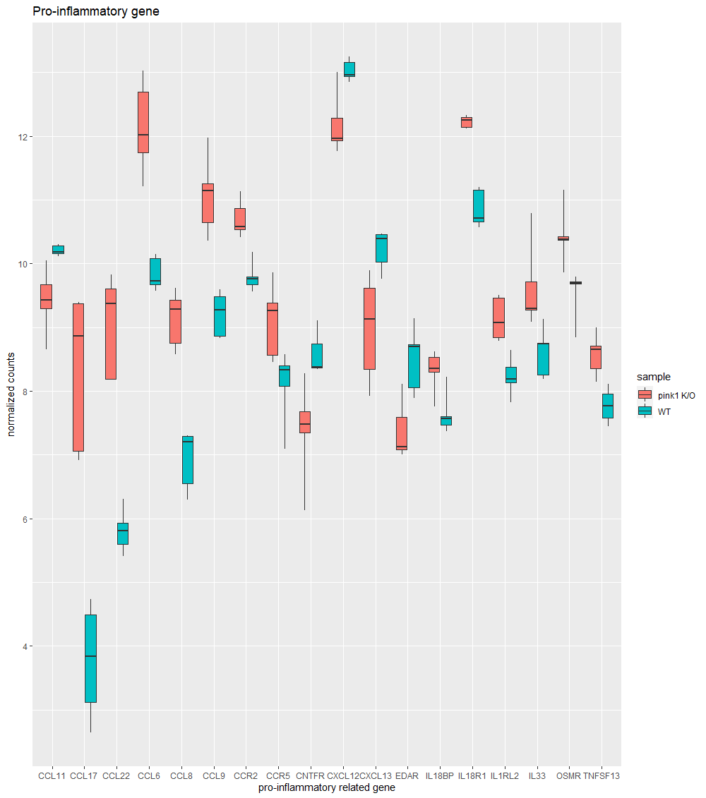
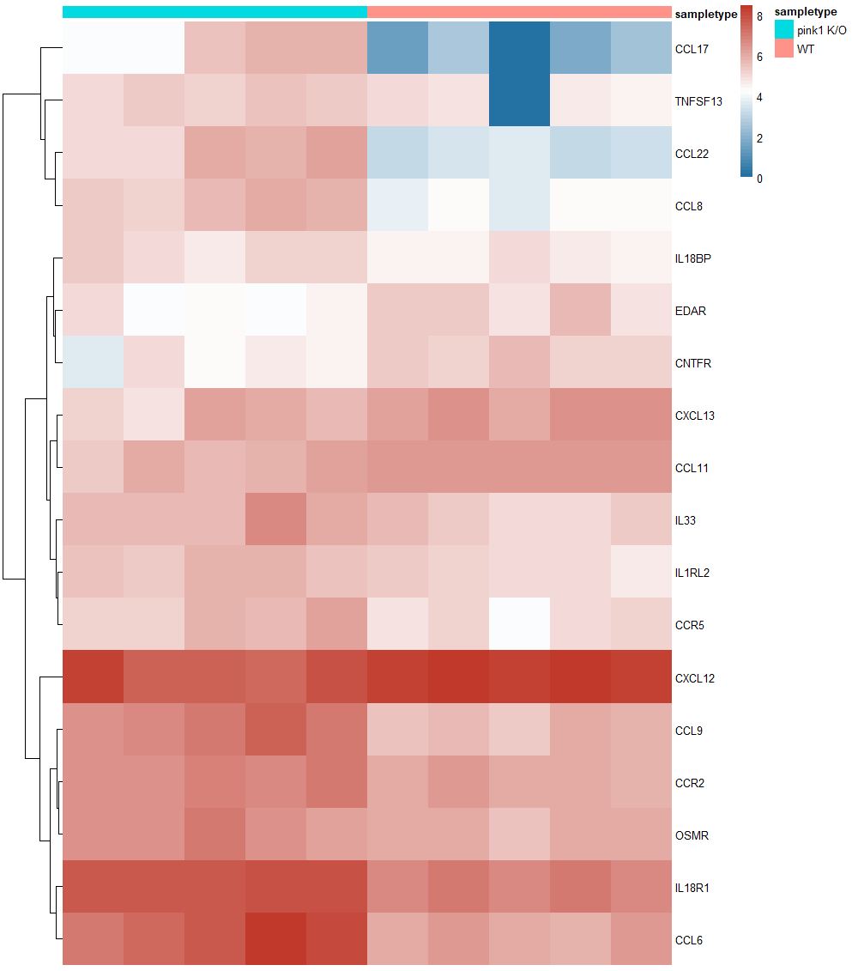
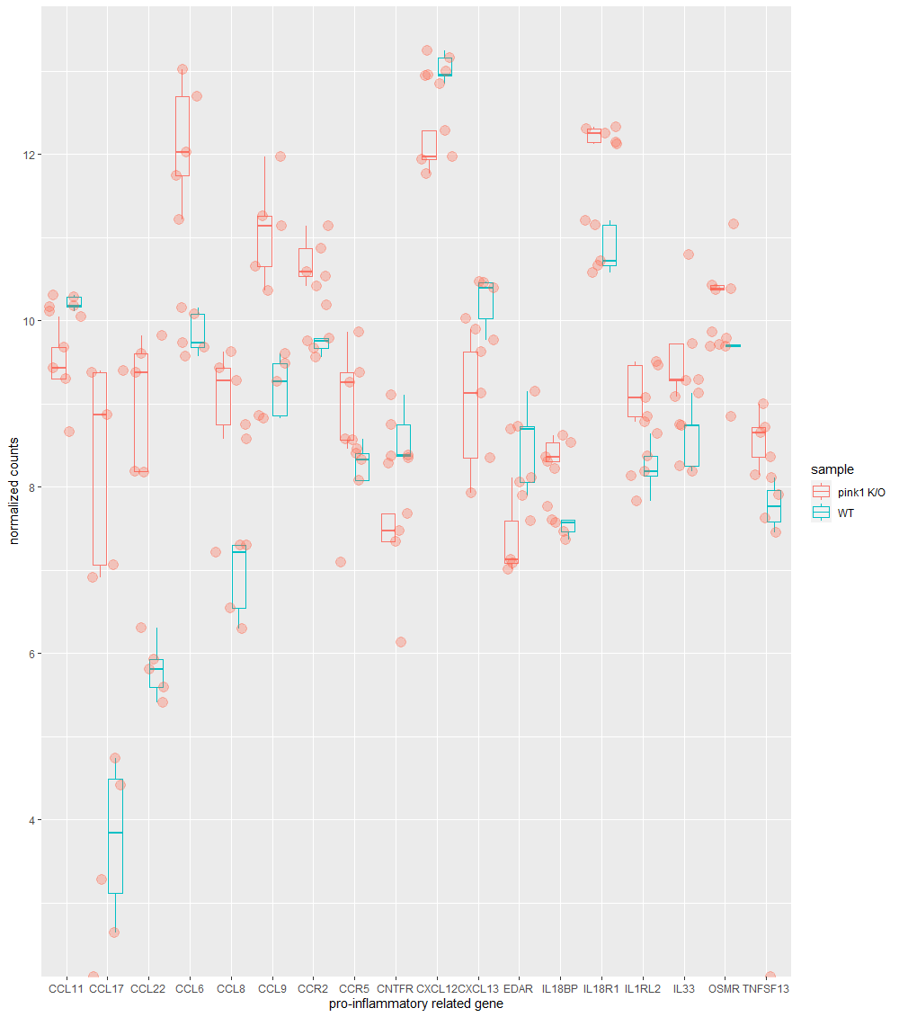

Slide 34


ROS And Oxidative Stress In Cell Signaling Transduction Related Products
Mitochondrial derived ROS
Mitochondrial fusion
Mitophage
via Pink1 K/O
SOD3 has been found to be more effective therapeutic target in emphysema than other isoforms of SOD
(Yao et al., 2010)
https://www.frontiersin.org/files/Articles/427526/fendo-10-00690-HTML

Slide 35


Gene ontology, pathway study – DAVID, GSEA
We got ...
791 UP regulated DE genes
371 DOWN regulated DE genes

Slide 36

UP pathway (adj p-value < 0.05)
Infectious disease
Cell migration (Immune cell (?))
Inflammatory response
Immune response

Slide 37

DOWN regulated pathway (adj p-value < 0.05)
Bunch of metabolic pathway

Slide 38



UP regulated gene ontology

Slide 39

DOWN regulated gene ontology

Slide 40


GSEA
Cell cycle arrest
Apoptosis
Inflammatory response
Immune response

Slide 41

Pathway analysis
UP & DOWN
Metabolic pathway
Cell cycle arrest
Necroptosis (?)
Apoptosis(?)
Immune response
Inflammation
via mitochondria dysfunction
OXIDATIVE PHOSPHORYLATION
FATTY ACID METABOLISM
METABOLIC PATHWAY
TCA CYCLE
CARBON CYCLE
HYPOXIA
E2F_TARGETS
G2M_CHECKPOINT
P53_PATHWAY
KRAS_SIGNALING
MYC_TARGETS
MITOTIC_SPINDLE
APOPTOSIS
COMPLEMENT
COAGULATION
APICAL_JUNCTION
CELL_ADHESION
INTERFERON_ALPHA_RESPONSE
INTERFERON_GAMMA_RESPONSE
INFECTION DEFENSE PATHWAY
LYSOSOME
PHAGOSOME ANTIGEN PROCESSING
CYTOKINE-CYTOKINE RECEPTOR INTERACTION
FOCAL ADHENSION
INFLAMMATORY_RESPONSE
IL2_STAT5_SIGNALING
IL6_JAK_STAT3_SIGNALING
TNFA_SIGNALING_VIA_NFKB

Slide 42
Expected pathway
Metabolic pathway
via mitochondria dysfunction
Immune cell
ATP decrease
ROS stress
Immune cell
cytokine
cytokine
Necroptosis (?)
Apoptosis(?)
APOPTOSIS
inflammatory
cytokine

Slide 43


Expected pathway
A)
B)
Inflammation
A) Pink1 k/O cells could have down regulated metabolism due to mitochondria dysfunction and ROS stress
B) Inflammation in thyroid due to dead cells

Slide 44


Immune cell composition – Pink1 K/O mouse
quanTIseq, MCPcounter
Gene # : 22996 -> 15891
Rik, Gm something # : 5819
LM22 missing : 72/547
! High possibility of inaccuracy alert !
May Inaccuracy occured during gene conversion process

Slide 45


Immune cell composition – Pink1 K/O mouse
CIBERSORT - Heatmap
Gene # : 22996 -> 15891
Rik, Gm something # : 5819
LM22 missing : 72/547
! High possibility of inaccuracy alert !
May Inaccuracy occured during gene conversion process

Slide 46

Immune cell composition – Pink1 K/O mouse
CIBERSORT – Bar plot
Gene # : 22996 -> 15891
Rik, Gm something # : 5819
LM22 missing : 72/547
! High possibility of inaccuracy alert !
May Inaccuracy occured during gene conversion process

Slide 47

So.. I’m gonna do…..
Parkin independent mitophagy pathway
ROS derived mitophagy, autophagy, apoptosis pathway
What’s going on immune cells ?
in the absence of functional autophagic machinery, damaged mitochondria can release reactive oxygen species (ROS) and DNA (mtDNA) that can further activate inflammasomes. This leads to activation of caspase-1, which can process pro-IL-1β into the mature bioactive cytokine.
James Harris et al,. 2017

Slide 48


PINK1 expression in lymphocytic thyroiditis
Normal tissue comparison
T-test, p-value : 7.02e-5

Slide 49



PINK1 expression in lymphocytic thyroiditis
Cancer(all) tissue comparison
T-test, p-value : 3.99e-5

Slide 50


PINK1 expression in lymphocytic thyroiditis
Cancer(FA/miFTC) tissue comparison
T-test, p-value : 0.448

Slide 51


PINK1 expression in lymphocytic thyroiditis
Cancer(FA only) tissue comparison
T-test, p-value : 0.821

Slide 52


PINK1 expression in lymphocytic thyroiditis
Cancer(miFTC only) tissue comparison
T-test, p-value : 0.821

Slide 53


PINK1 expression in lymphocytic thyroiditis
Cancer(FVPTC) tissue comparison
T-test, p-value : 0.00621

Slide 54


PINK1 expression in lymphocytic thyroiditis
Cancer(PTC) tissue comparison
T-test, p-value : 0.0898

Slide 55


PINK1 expression in lymphocytic thyroiditis
Summary
Type | LT | no-LT | p-value | Adj p-value
Normal | 24 | 57 | 7.02e-05 | 0.000351
FA | 4 | 21 | 8.21e-01 | 0.821
miFTC | 7 | 23 | 1.29e-01 | 0.2694
FVPTC | 16 | 33 | 6.21e-03 | 0.02484
PTC | 37 | 39 | 8.98e-02 | 0.2694

Slide 56


PINK1 expression in lymphocytic thyroiditis
Summary
Type | # | p-value | Adj p-value
FA | 25 | 4.30e-04 | 0.00086
miFTC | 30 | 7.86e-05 | 0.000236
FVPTC | 49 | 4.72e-01 | 0.472
PTC | 76 | 4.85e-05 | 0.000194
# Normal : 81

Slide 57


PINK1 expression in lymphocytic thyroiditis
Summary
Type | # | p-value | Adj p-value
Normal | 81 | 1.16e-01 | 2.32e-01
FA | 25 | 1.00e-03 | 4.00e-03
miFTC | 30 | 74.35e-04 | 2.00e-03
FVPTC | 49 | 6.94e-01 | 6.94e-01
PTC | 76 | 1.86e-09 | 9.30e-09
# Total : 261

Slide 58

PINK1 expression in lymphocytic thyroiditis
GTEx
# No-LT : 568
# LT : 47

